Slide 1
SECURE DATA HIDING IN IMAGES USING STEGANOGRAPHY
CAPSTONE PROJECT
Presented By: Kalla Bharath Sai Durga Akhil
Student Name : Kalla Akhil
College Name & Department : GITAM University (CSE CS)

Slide 2
OUTLINE
Problem Statement
Technology used
Wow factor
End users
Result
Conclusion
Git-hub Link
Future scope

Slide 3
Problem Statement
The problem involves concealing sensitive information within digital images using steganography techniques, making the hidden data undetectable to casual observers. This project aims to develop robust methods for embedding secret messages in images without visibly altering their appearance, while ensuring the hidden data remains recoverable only by authorized recipients. The challenge includes maximizing data capacity while maintaining image quality and implementing encryption for additional security against unauthorized extraction attempts.

Slide 4
Technology used
Libraries Used
OpenCV (cv2) – For reading and modifying image files.
OS (os) – For interacting with the operating system (e.g., opening files).
Platforms & IDEs
Python 3.x – Compatible with Python 3.6 and later.
IDEs:
PyCharm – Fully supported for debugging and execution.
IDLE – Works but lacks advanced debugging features.
VS Code – Supports execution with extensions like "Python" and "Jupyter".
Supported Hardware
PC/Laptops (Windows, Linux, macOS) – Works on all major operating systems.

Slide 5
Wow factors
Steganography with Passcode: Hides messages in images with added security.
Simple Encoding/Decoding: Uses ASCII to pixel conversion for message hiding.
Automatic Image Display: Opens the encrypted image immediately after creation.
Basic Security Check: Requires correct passcode for message decryption.
Educational: Demonstrates fundamental concepts in image manipulation and cryptography.
Uses OpenCV: Leverages a popular library for image processing.
Interactive: User inputs for message, passcodes, enhancing engagement.

Slide 6
End users
Students/Educators: in computer science or cryptography.
Coding Hobbyists: interested in steganography.
Security Enthusiasts: exploring basic security concepts.
Digital Artists: for embedding messages in artwork.
Privacy Advocates: for discreet communication.
Teachers: for classroom demonstrations.
DIY Tech Enthusiasts: for fun projects.

Slide 7
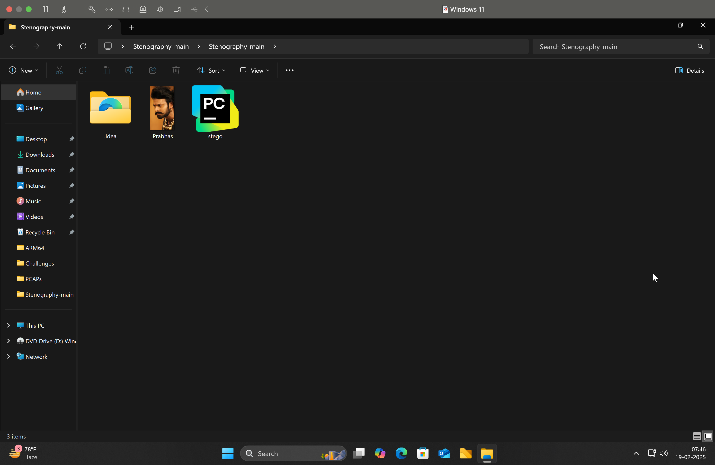
Results
Before Files

Slide 8
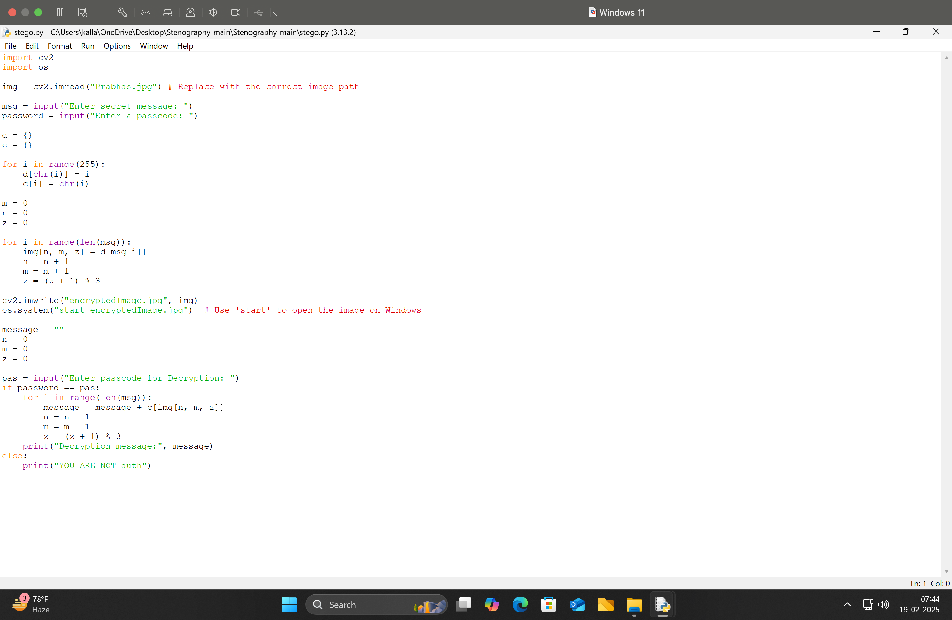
Results
Source Code

Slide 9
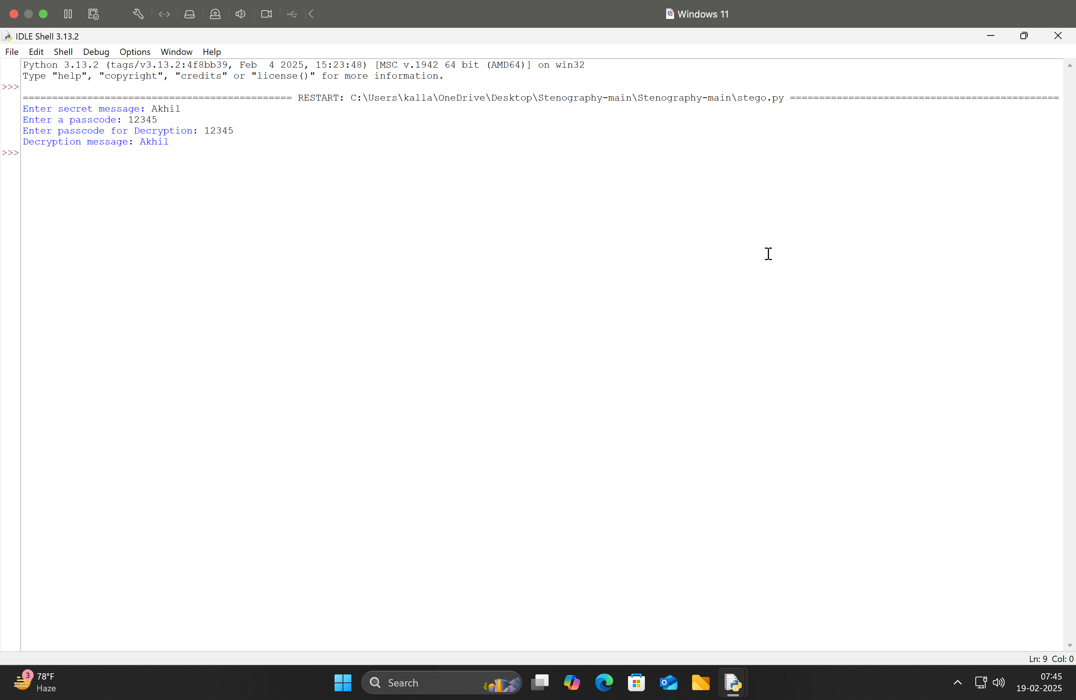
Results
Output

Slide 10
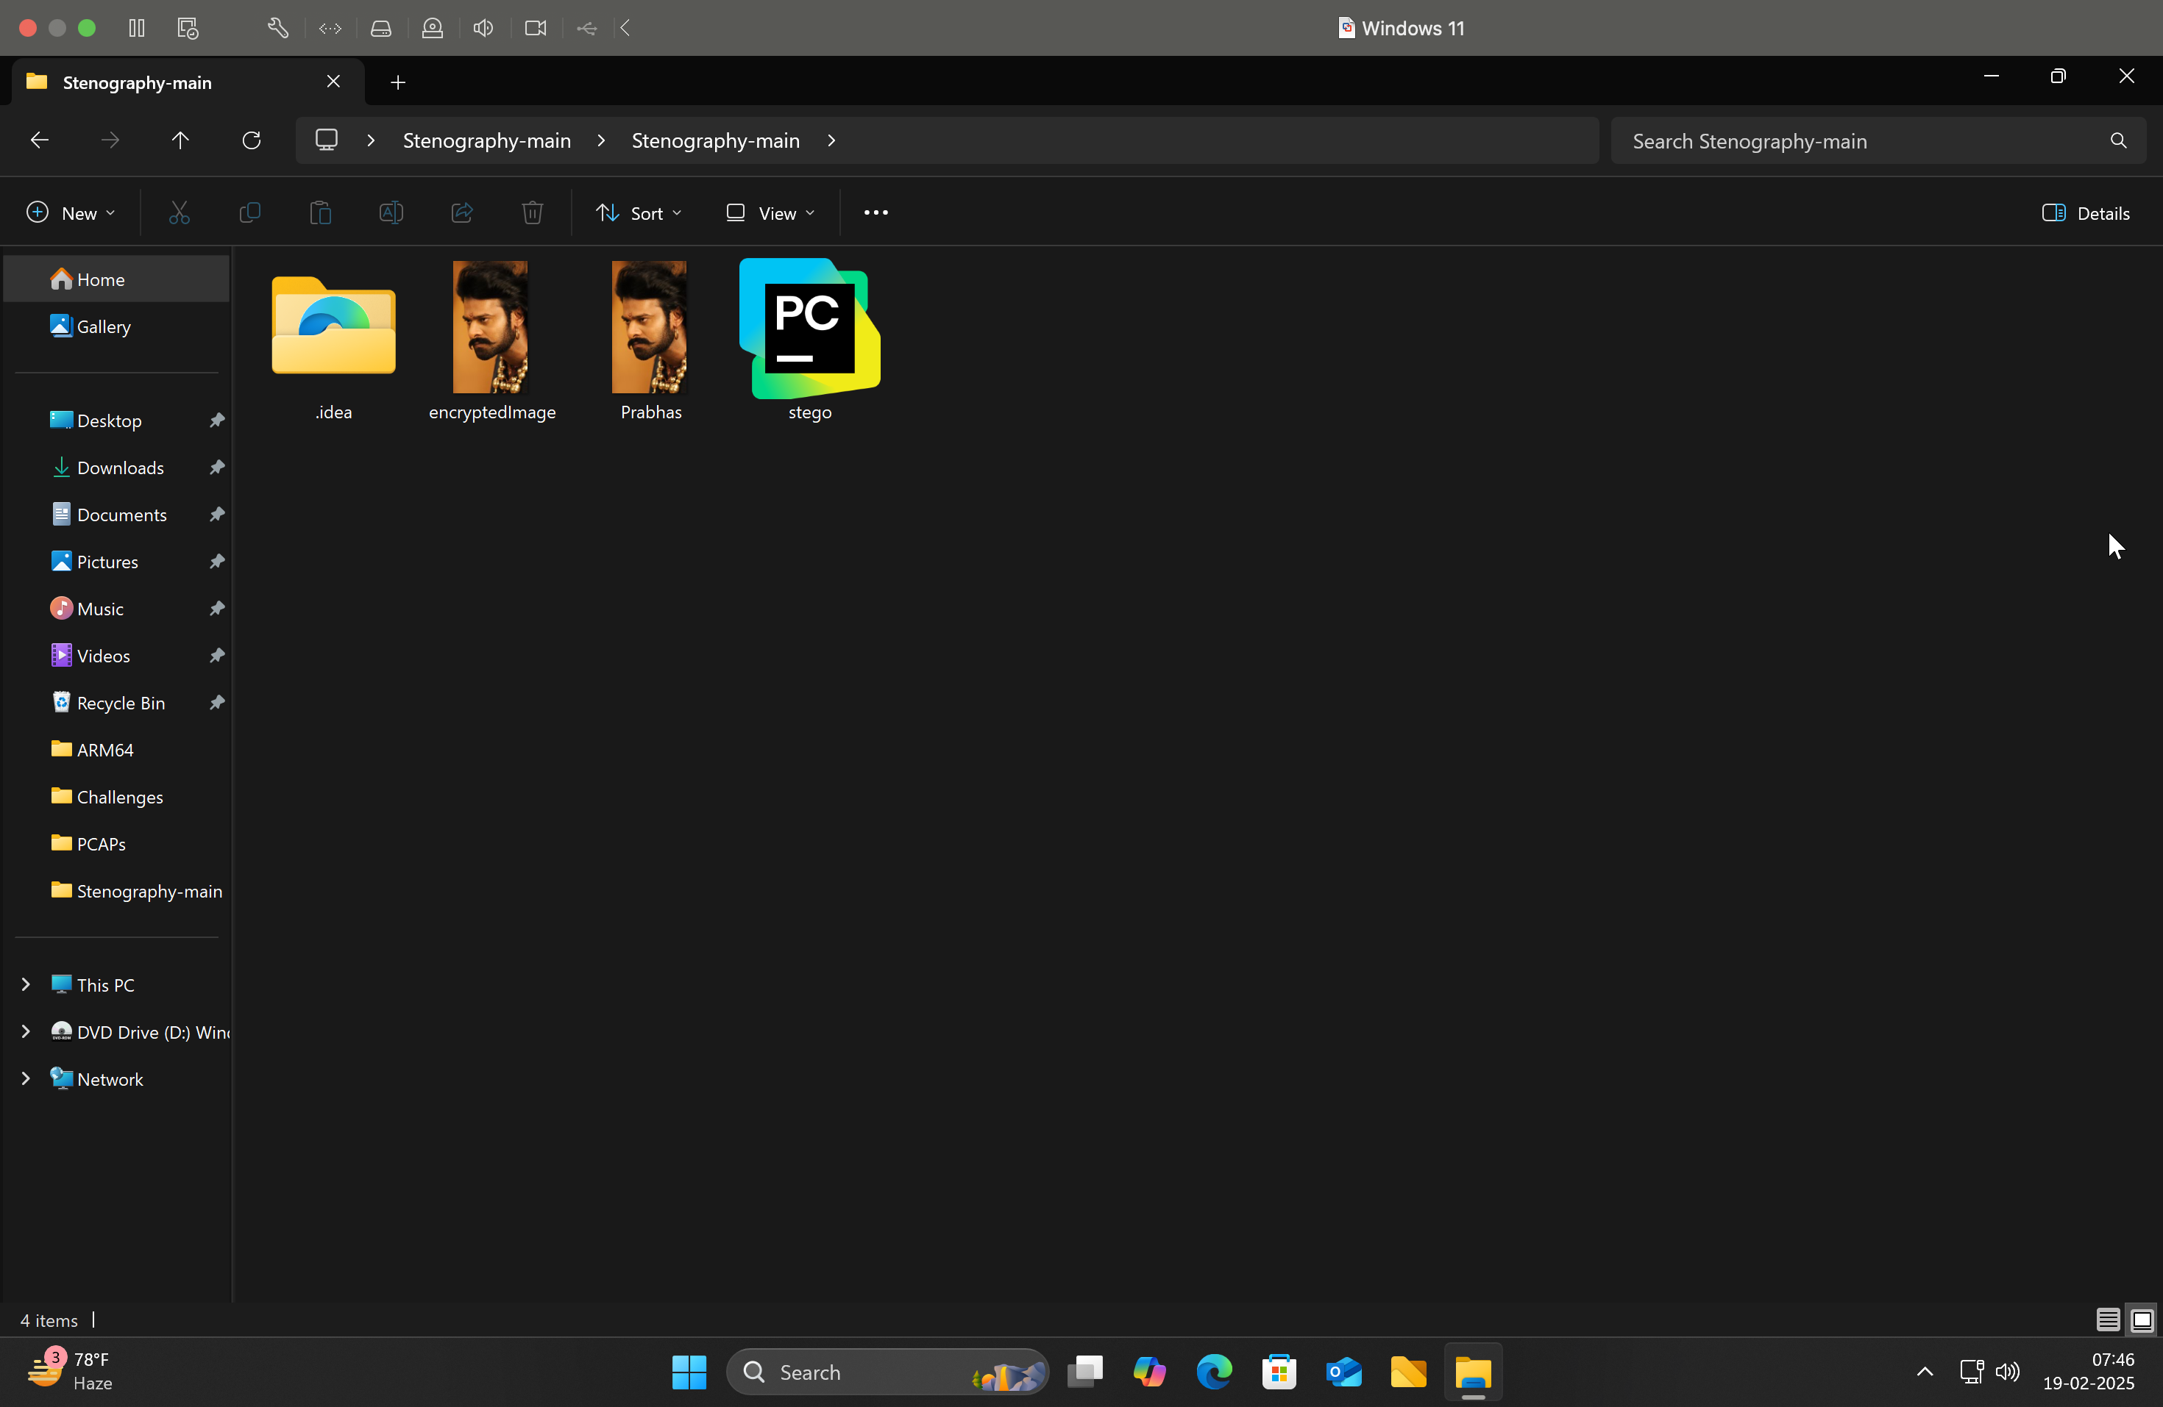
Results
Output Encrypted Image

Slide 11
Conclusion
Successfully embeds messages into images: using steganography.
Adds passcode security: for encoding and decoding.
Educational tool: for learning about cryptography and image processing.
Interactive: with user input for messages and passcodes.
Ideal for beginners: but not for high-security needs.

Slide 12
GitHub Link
https://github.com/Akhi-hecker/myStego.git

Slide 13
THANK YOU

